Slide 1

Support Vector Machines

Slide 2
SVM Background.
Formalized in the early 1990’s, SVM’s are a classification algorithm that come from a family of kernel methods (we will discuss kernels later)
The broad approach in SVM’s is to find a hyperplane that acts a a decision boundary between classes. It can be used both in the binary and multi-class setting.
Before continuing, let us consider what a hyperplane actually is.

Slide 3
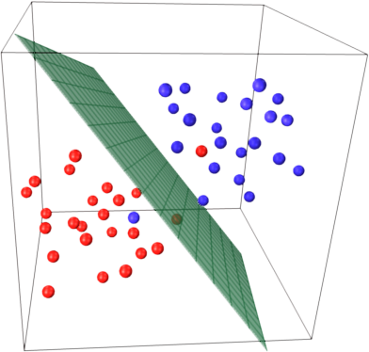
What is a Hyperplane?
In a p-dimensional space (think of p as features), a hyperplane is a parallel subspace (parallel implies the subspace may not pass through the origin) of p-1 dimensions.
So in a 2-D setting (x,y), a hyperplane is just a line of 1-D (2-1) of the equation β₀ + β₁X₁ + β₂X₂ = 0 . This is just our linear regression line.
In a 3-D setting a hyperplane is a flat 2-D space, a plane. Look below:

Slide 4
Hyperplanes in higher dimensions
A hyperplane in p dimensions has the form β₀ +β₁X₁ +β₂X₂ +...+β_{p}X_{p} =0.
This means that for any X = (X₁,X₂,...,X_{p}) for which the above equation is true, is a point on the p-1 dimensional hyperplane.
If for any values of X = (X₁,X₂,...,X_{p}) for which the above equation is not satisfied (is not equal to 0), then X lies on one or the other side of the hyperplane.
That is, X points that satisfy β₀ +β₁X₁ +β₂X₂ +...+β_{p}X_{p} < 0 or β₀ +β₁X₁ +β₂X₂ +...+β_{p}X_{p} > 0 lie on either side the hyperplane.
Let's assume, we are solving a binary classification problem where y ={1,-1}.

Slide 5
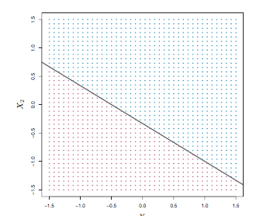
Hyperplanes in higher dimensions
-Then we classify the test observation x_{i} based on the sign of f(x_{i}) = β₀ +β₁X₁ +β₂X₂ +...+β_{p}X_{p} . If f(x_{i}) is positive, then we assign the test observation to class 1, and if f(x_{i}) is negative, then we assign it to class −1.
The line in the figure is defined by 1 + 2X_{i} + 3X_{i} = 0
So, for X₁ = -0.5 and X₂ = -0.5, the equation is < 0, so we predict the purple class.
If f(x_{i}) is far from 0, we can be sure the classification is correct.

Slide 6
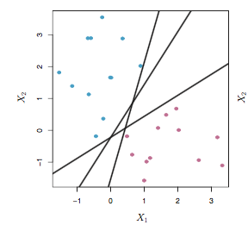
But, which hyperplane is best?
There are many potential hyperplanes that can defined in p-dimensional subspace such that observations from two classes fall on either side.
Which is the best decision boundary here?Why?

Slide 7
Maximal Hyperplane Classifier
If we want to minimize the probability of misclassifying, would we not want a hyperplane that separates the two classes the most?
This is called the maximal margin hyperplane, as we can compute the (perpendicular) distance from each training observation to a given separat- ing hyperplane; the smallest such distance is the minimal distance from the observations to the hyperplane, also called the margin.
The maximal margin hyperplane is the separating hyperplane for which the margin is largest. Now, We can then classify a test observation based on which side of the maximal margin hyperplane it lies.
The hope is that a classifier that has a large margin on the training data will also have a large margin on the test data.

Slide 8
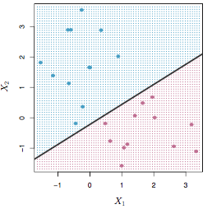
Maximal Hyperplane Classifier
The classifier is the mid-line max distance on both sides.

Slide 9

Maximal Hyperplane Classifier
The two observations through which the outer-limits are defined are knowns as Support Vectors in that they “support” the maximal margin hyperplane. If these points were moved slightly then the maximal margin hyperplane would move as well.
So, our classifier actually depends only on the points knowns as support vectors and not all other observations as they have no impact on its location.
Bias and Variance analysis?
This classifier is constructed by maximizing the margin given this constraint:
B₀+ ∑B_{p}X =

Slide 10
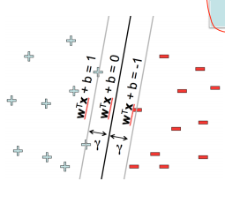
Maximal Hyperplane Classifier

Slide 11
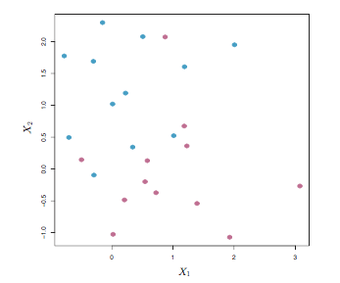
What if something is not linearly separable?
In the image below it is clear that there is no perfect linear hyperplane than can separate the classes
Even if found a perfect linear hyperplane, it would be so close to its support vectors as to be oversensitive. So, lets not aim for perfection...

Slide 12
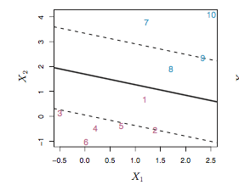
Support Vector Classifier
The generalization of the maximal margin classifier to the non-separable case is known as the support vector classifier.
Here, we are willing to give up perfect classification and what we may gain in return is lower variance (sensitivity to individual points), better classification of most observations.
We accomplish this by introducing a soft margin.The margin is soft because it can be violated by some of the training observations.

Slide 13

How to relax the margins: Slack Variables
Lets revisit our maximization problem, but lets add something called slack variables ⍷_{i}. A slack variables is something that allow individual observations to be on the wrong side of the margin or the hyperplane.
B₀+ ∑B_{p}X =
The slack variable ⍷_{i} tells us where the ith observation is located, relative to the hyperplane and relative to the margin. If ⍷_{i} = 0 then the ith observation is on the correct side of the margin.
If ⍷_{i}> 0 then the ith observation is on the wrong side of the margin, and we say that the ith observation has violated the margin. If ⍷_{i} > 1 then it is on the wrong side of the hyperplane.

Slide 14
C
So, how do we control how the number of misclassified point we want? We can calculate the ∑⍷_{i,}that is the sum of the slack variables. We do this by bounding ∑⍷i, by C. That is, C is the maximum amount of violations to the margin (and to the hyperplane) that we will tolerate.
If C = 0 then there is no budget for violations to the margin, and it must be the case that ⍷i = ... = ⍷i = 0. For C > 0 no more than C observations can be on the wrong side of the hyperplane.
C is therefore a tuning parameter that is estimated by cross-validation.

Slide 15
Computing a non-linear decision boundary with SVC
How did we add non-linearity in the context of OLS? POLYNOMIAL TERMS.
We can do the same here, while maximizing the margin with constraint
B₀+ ∑B_{p}X + ∑B²_{p}X =
Why does this lead to a non-linear decision boundary? In the enlarged feature space, the decision boundary that results from the above equation is in fact linear. But in the original feature space, the decision boundary is of the form of a quadratic polynomial, and its solutions are non-linear.

Slide 16
Finally, Support Vector Machines.
SVM is an extension of the support vector classifier that results from enlarging the feature space in a specific way, using kernels. So now, we can relax the necessity of linearity (hyperplanes can only achieve linear decision boundaries).
However, expanding to a larger feature space means much more computational expense.
The solution to the predicament lies here in taking the inner products of the observations. That is, we think of an observation as a 1-D vector, a single point.
The inner product of two r-vectors x_{i}, x_{i+1}is defined as ⟨x_{i}, x_{i+1}⟩ = ∑ x_{i},x_{i+1}.

Slide 17

Support vector classifier with inner product
If we used our old hyper plane function f(x_{i}) =
The alpha is the same as our Beta B, and the notation i ⍷ S implies that if a training observation is not a support vector, then its α_{i} equals zero. So S is the collection of indices of these support points.
To estimate the parameters α₁,...,α_{n} and β₀, all we need are the (n choose 2) inner products ⟨x_{i}, x_{i+1}⟩ between all pairs of training observation bounded by S.

Slide 18
Kernel Trick
Taking the inner products in a particular way is called kernel trick because we are enlarging the feature space so that we can find a hyperplane in the new dimension. However, by taking the inner products, we are actually doing the computation in the original dimension.
Taking the inner product, or v∗u, it would basically be the length projection of v onto u (the part of v in direction of u) multiplied by the length of u. So you basically have a measure of how much the vectors move in same direction.
If we generalize taking the inner product and instead of ⟨x_{i}, x_{i+1}⟩ = ∑ xi, x_{i+1}, use a kernel function K (x_{i}, x_{i+1} ). A kernel is a function that quantifies the similarity of two observations.

Slide 19

Three Kernel Functions
Linear Kernel : K (x_{i}, x_{i+1} ) = ∑ xi, x_{i+1}, [ SAME AS BEFORE ]
Polynomial kernel : K (x_{i}, x_{i+1} ) = (1 +∑x_{ij} x_{i+1 j} )^{d} .U sing such a kernel with d > 1, instead of the linear kernel in the support vector classifier algorithm leads to a much more flexible decision boundary.
Radial Bias kernel K (x_{i}, x_{i+1} ) =
γ is a positive constant.
If a test observation is far from a training observation, this means that the result of K (x_{i}, x_{i+1} ) will be a very tiny number.
This means that the radial kernel has very local behavior, in the sense that only nearby training observations have an effect on the class label of a test observation.

Slide 20
RBF Kernel
-The advantage of the radial kernel is computational, and it amounts to the fact that using kernels, one need only compute K(x_{i}, x_{i+1}) for all 􏰉n choose 2􏰀 distinct pairs i, i+1.

Slide 21
SVM with more than 2 classes
One versus one: A one-versus-one approach constructs 􏰉K choose 2 - SVMs, each of which compares a pair of classes. We classify a test observation using each of the 􏰉K choose 2 􏰀 classifiers, and we tally the number of times that the test observation is assigned to each of the K classes. The final classification is performed by assigning the test observation to the class to which it was most frequently assigned in these 􏰉K choose 2 􏰀 pairwise classifications.
One versus all : We fit K SVMs, each time comparing one of all the K classes to the other remaining K−1 classes.

